Slide 1
Post Earnings Announcement Drift
Efficient Market Hypothesis (EMH) - asset prices fully reflect all available information and the market only moves by reacting to new information.
But, there’s anomaly…
Post Earnings Announcement Drift (PEAD) - It has long been noted that after earnings are announced, estimated cumulative abnormal returns continue to drift up for firms that are perceived to have reported good financial results for the preceding quarter and drift down for firms whose results have turned out worse than the market had expected.
Student: Zhengxin Ye, Supervisor: Thomas Heinis

Slide 2
Student: Zhengxin Ye, Supervisor: Thomas Heinis
Input and Output
Inputs
Financial Statement data
Earnings Surprise data
Price Movements data
Momentum Indicator data
Output
30 day price movement direction or magnitude

Slide 3
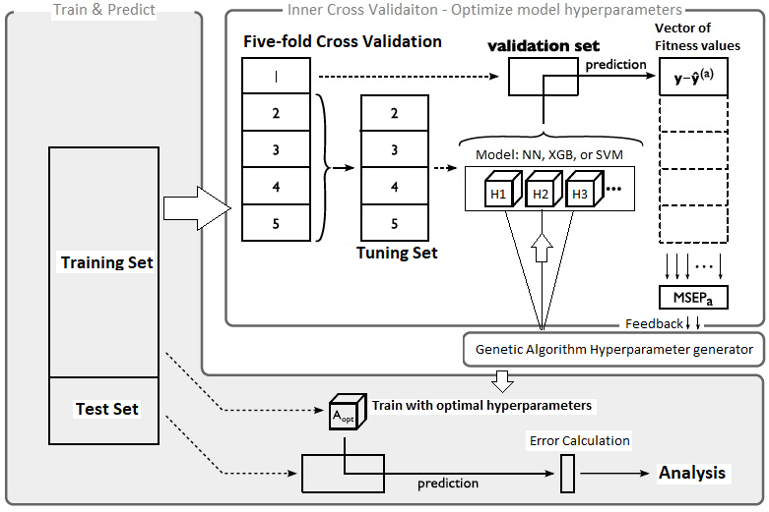
Student: Zhengxin Ye, Supervisor: Thomas Heinis
System Structure

